Slide 1

Welcome to Our Android App for Learning
Buy Courses, Pay Fees, and Interact Seamlessly!

Slide 2
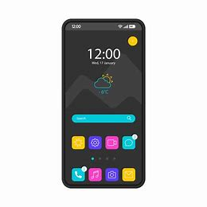
Introduction
Our Android app revolutionizes learning! With us, you can access a plethora of courses, interact with teachers, and pay your fees hassle-free.

Slide 3
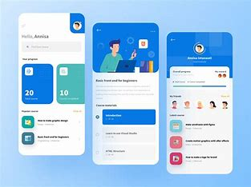
Buy and Sell Courses
Browse through our extensive collection of courses. Click on 'Buy' to purchase a course or 'Sell' to offer your own expertise.

Slide 4

Secure Payments
Pay your fees securely within the app. Whether it's tuition fees to the school or payments to individual teachers, our app ensures safe transactions.

Slide 5
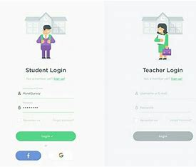
Customized Experience
Enjoy a tailored experience based on your role. Students can access course materials and pay fees, while teachers can manage courses and receive payments.

Slide 6

Firewall Database Security
Rest assured, our app's backend is fortified by a firewall database. Your data remains protected at all times, ensuring confidentiality and integrity.

Slide 7

Join Us Now!
Don't miss out on the opportunity to revolutionize your learning experience. Download our app today and embark on a journey of knowledge and growth!

Slide 8

Have Questions?
For any inquiries or assistance, feel free to reach out to us. We're here to help!

